Slide 1
Offline Components:
Collaborative Filtering in Cold-start Situations

Slide 2

Problem
Algorithm selects
Item j with
item features x_{j}
(keywords, content categories, ...)
User i
with
user features x_{i}
(demographics,
browse history,
search history, …)
(i, j) : response y_{ij}
visits
(explicit rating, implicit click/no-click)
Predict the unobserved entries based on
features and the observed entries
Notes:
During time interval t
User visits to the webpage
Some item inventory at our disposal
Decision problem: for each visit, select an item to display
each display generates a response
Goal: choose items to maximize expected clicks

Slide 3
Model Choices
Feature-based (or content-based) approach
  Use features to predict response
    (regression, Bayes Net, mixture models, …)
  Limitation: need predictive features
    Bias often high, does not capture signals at granular levels
Collaborative filtering (CF aka Memory based)
  Make recommendation based on past user-item interaction
    User-user, item-item, matrix factorization, …
    See [Adomavicius & Tuzhilin, TKDE, 2005], [Konstan, SIGMOD’08 Tutorial], etc.
  Better performance for old users and old items
  Does not naturally handle new users and new items (cold-start)

Slide 4
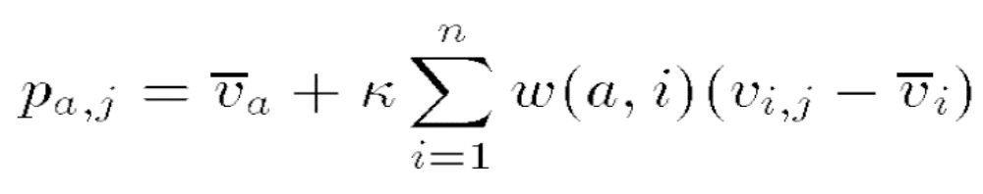
Collaborative Filtering (Memory based methods)
User-User Similarity
Item-Item similarities, incorporating both
    Estimating Similarities
      Pearson’s correlation
      Optimization based (Koren et al)

Slide 5
How to Deal with the Cold-Start Problem
Heuristic-based approaches
  Linear combination of regression and CF models
  Filterbot
    Add user features as psuedo users and do collaborative filtering
  Hybrid approaches
    Use content based to fill up entries, then use CF
Matrix Factorization
  Good performance on Netflix (Koren, 2009)
Model-based approaches
  Bilinear random-effects model (probabilistic matrix factorization)
    Good on Netflix data [Ruslan et al ICML, 2009]
  Add feature-based regression to matrix factorization
    (Agarwal and Chen, 2009)
  Add topic discovery (from textual items) to matrix factorization
    (Agarwal and Chen, 2009; Chun and Blei, 2011)

Slide 6
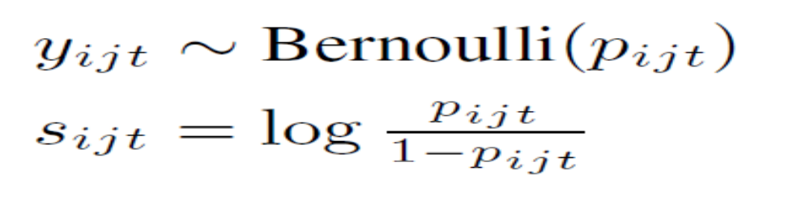
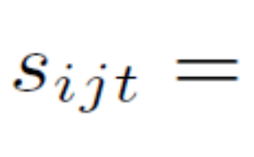

Per-item regression models
When tracking users by cookies, distribution of visit patters could get extremely skewed
  Majority of cookies have 1-2 visits
Per item models (regression) based on user covariates attractive in such cases

Slide 7
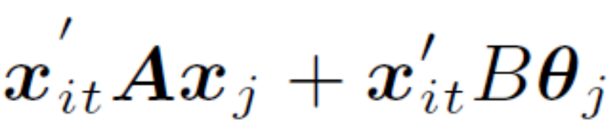
Several per-item regressions: Multi-task learning
Agarwal,Chen and Elango, KDD, 2010
Low dimension
(5-10),
B estimated
retrospective data
Affinity to old items

Slide 8
Per-user, per-item models
via bilinear random-effects model

Slide 9
Motivation
Data measuring k-way interactions pervasive
  Consider k = 2 for all our discussions
    E.g. User-Movie, User-content, User-Publisher-Ads,….
  Power law on both user and item degrees
Classical Techniques
  Approximate matrix through a singular value decomposition (SVD)
    After adjusting for marginal effects (user pop, movie pop,..)
  Does not work
    Matrix highly incomplete, severe over-fitting
  Key issue
    Regularization of eigenvectors (factors) to avoid overfitting

Slide 10
Early work on complete matrices
Tukey’s 1-df model (1956)
  Rank 1 approximation of small nearly complete matrix
Criss-cross regression (Gabriel, 1978)
Incomplete matrices: Psychometrics (1-factor model only; small data sets; 1960s)
Modern day recommender problems
  Highly incomplete, large, noisy.

Slide 11

Latent Factor Models
u
sporty
v
“newsy”
Affinity = u’v
item
“sporty”
s
z
“newsy”
Affinity = s’z

Slide 12
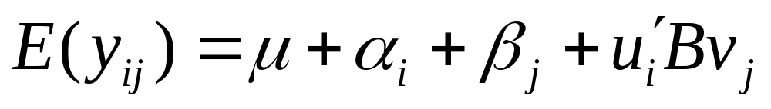
Factorization – Brief Overview
Latent user factors: (α_{i} , u_{i}=(u_{i1},…,u_{in}))
(Nn + Mm) parameters
Key technical issue:
Latent movie factors: (β_{j} , v_{j}=(v _{j1},….,v _{jn}))
will overfit for moderate values of n,m
Regularization
Interaction

Slide 13
Latent Factor Models: Different Aspects
Matrix Factorization
  Factors in Euclidean space
  Factors on the simplex
Incorporating features and ratings simultaneously
Online updates

Slide 14
Maximum Margin Matrix Factorization (MMMF)
Complete matrix by minimizing loss (hinge,squared-error) on observed entries subject to constraints on trace norm
  Srebro, Rennie, Jakkola (NIPS 2004)
    Convex, Semi-definite programming (expensive, not scalable)
Fast MMMF (Rennie & Srebro, ICML, 2005)
  Constrain the Frobenious norm of left and right eigenvector matrices, not convex but becomes scalable.
Other variation: Ensemble MMMF (DeCoste, ICML2005)
  Ensembles of partially trained MMMF (some improvements)

Slide 15
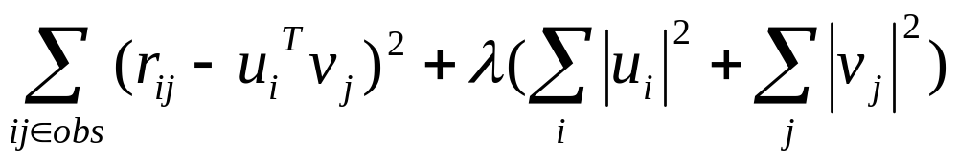
Matrix Factorization for Netflix prize data
Minimize the objective function
Simon Funk: Stochastic Gradient Descent
Koren et al (KDD 2007): Alternate Least Squares
  They move to SGD later in the competition

Slide 16
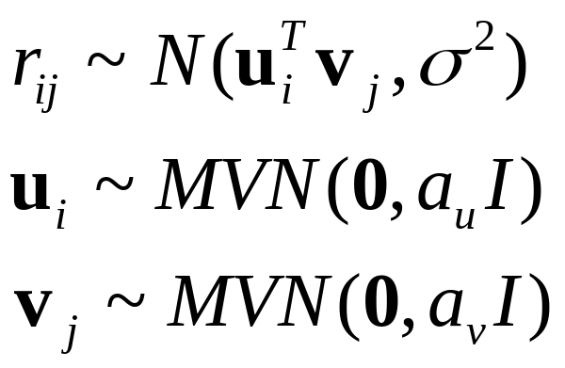
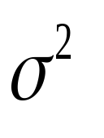
Probabilistic Matrix Factorization (Ruslan & Minh, 2008, NIPS)
a_{u}
a_{v}
Optimization is through Gradient Descent (Iterated conditional modes)
Other variations like constraining the mean through sigmoid, using “who-rated-whom”
Combining with Boltzmann Machines also improved performance
u_{i}
v_{j}
r_{ij}

Slide 17

Bayesian Probabilistic Matrix Factorization (Ruslan and Minh, ICML 2008)
Fully Bayesian treatment using an MCMC approach
Significant improvement
Interpretation as a fully Bayesian hierarchical model shows why that is the case
  Failing to incorporate uncertainty leads to bias in estimates
  Multi-modal posterior, MCMC helps in converging to a better one
MCEM also more resistant to over-fitting
r
Var-comp: a_{u}

Slide 18
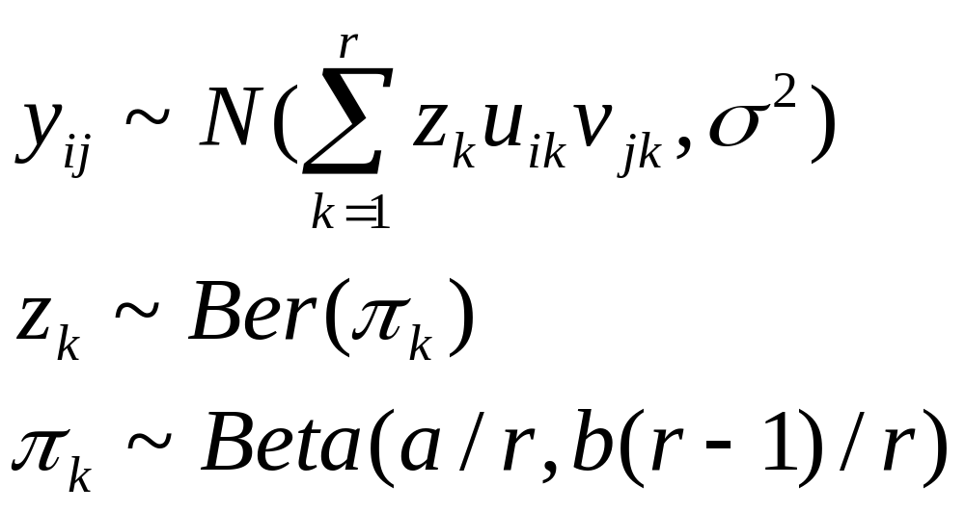
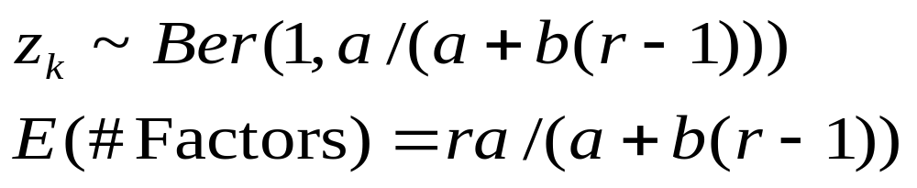
Non-parametric Bayesian matrix completion
(Zhou et al, SAM, 2010)
Specify rank probabilistically (automatic rank selection)

Slide 19
How to incorporate features:
Deal with both warm start and cold-start
Models to predict ratings for new pairs
  Warm-start: (user, movie) present in the training data with large sample size
  Cold-start: At least one of (user, movie) new or has small sample size
    Rough definition, warm-start/cold-start is a continuum.
Challenges
  Highly incomplete (user, movie) matrix
  Heavy tailed degree distributions for users/movies
    Large fraction of ratings from small fraction of users/movies
  Handling both warm-start and cold-start effectively in the presence of predictive features

Slide 20
Possible approaches
Large scale regression based on covariates
  Does not provide good estimates for heavy users/movies
  Large number of predictors to estimate interactions
Collaborative filtering
  Neighborhood based
  Factorization
    Good for warm-start; cold-start dealt with separately
Single model that handles cold-start and warm-start
  Heavy users/movies → User/movie specific model
  Light users/movies → fallback on regression model
  Smooth fallback mechanism for good performance

Slide 21
Add Feature-based Regression into
Matrix Factorization
RLFM: Regression-based Latent Factor Model

Slide 22
Regression-based Factorization Model (RLFM)
Main idea: Flexible prior, predict factors through regressions
Seamlessly handles cold-start and warm-start
Modified state equation to incorporate covariates

Slide 23
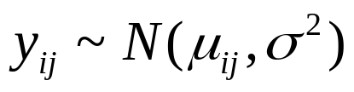
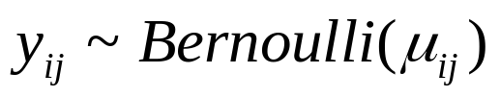
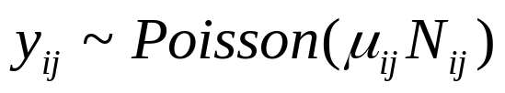
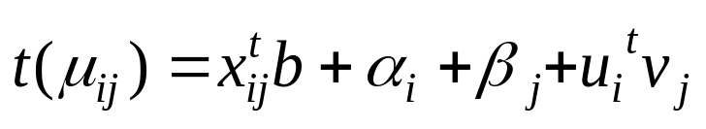
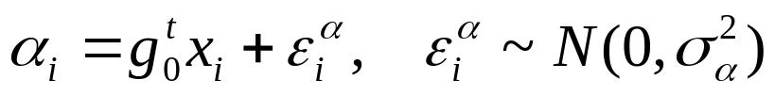
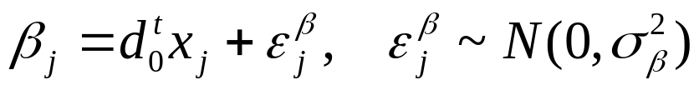
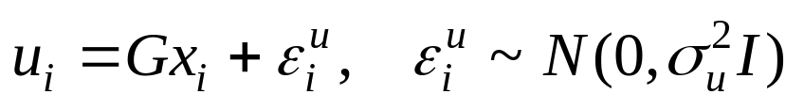
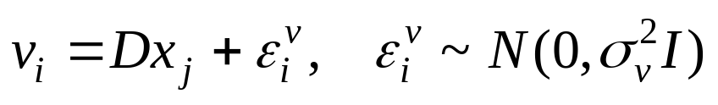
RLFM: Model
Rating:
Gaussian Model
user i
gives
item j
Logistic Model (for binary rating)
Poisson Model (for counts)
Bias of user i:
Popularity of item j:
Factors of user i:
Factors of item j:
Could use other classes of regression models

Slide 24
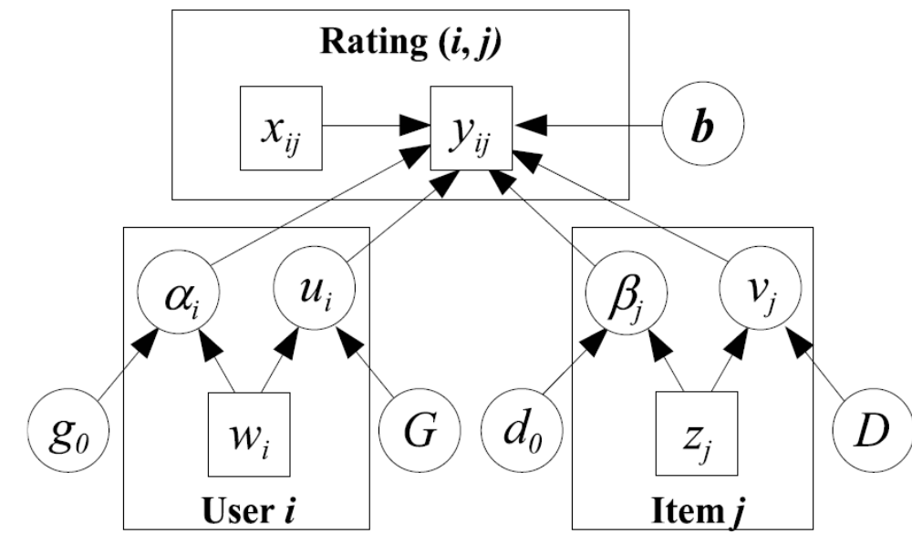
Graphical representation of the model

Slide 25

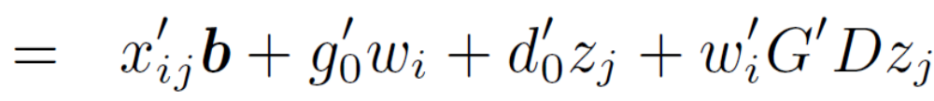

Advantages of RLFM
Better regularization of factors
  Covariates “shrink” towards a better centroid
Cold-start: Fallback regression model (FeatureOnly)

Slide 26
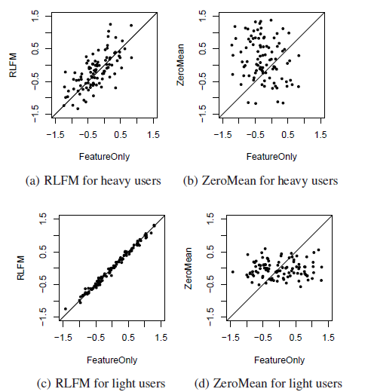
RLFM: Illustration of Shrinkage
Plot the first factor value for each user
(fitted using Yahoo! FP data)

Slide 27
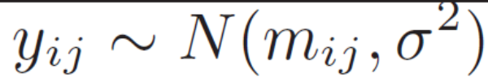

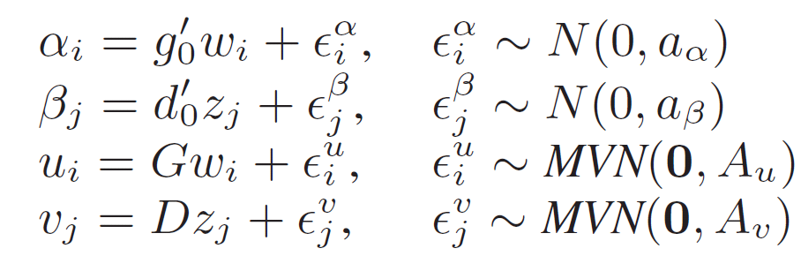
Induced correlations among observations
Hierarchical random-effects model
Marginal distribution obtained by integrating out random effects

Slide 28
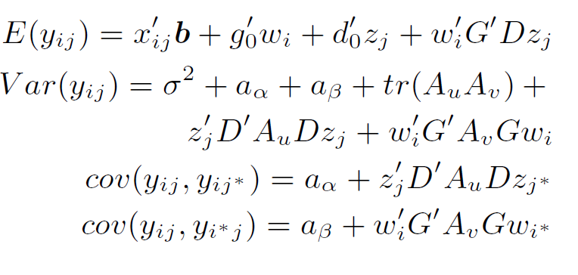
Closer look at induced marginal correlations

Slide 29
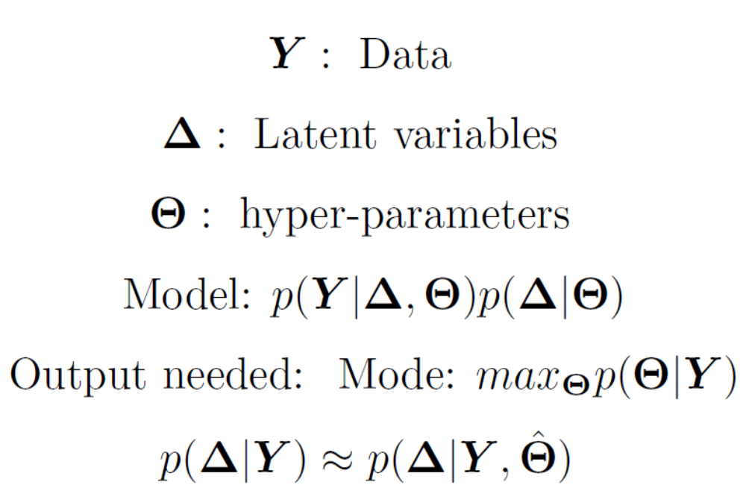
Model fitting: EM for our class of models

Slide 30
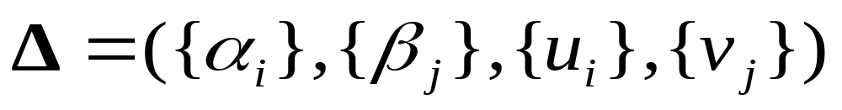
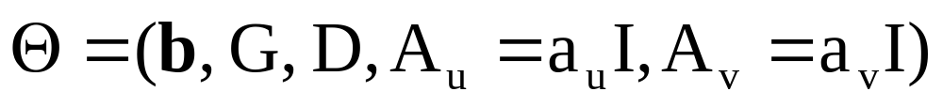
The parameters for RLFM
Latent parameters
Hyper-parameters

Slide 31
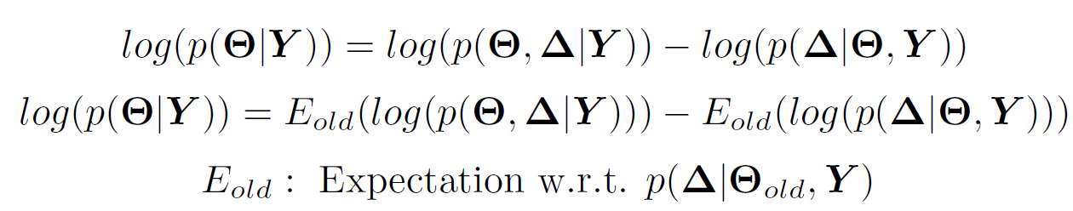
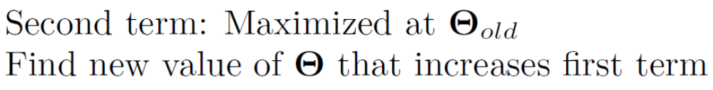
Computing the mode
Minimized

Slide 32
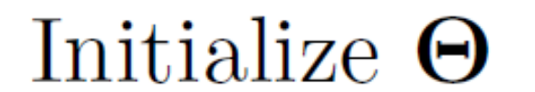
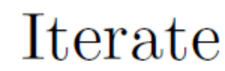
The EM algorithm

Slide 33



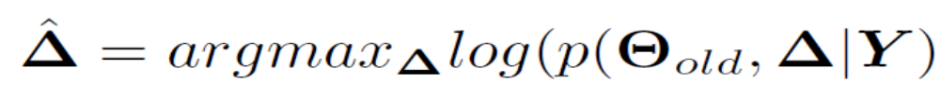
Computing the E-step
Often hard to compute in closed form
Stochastic EM (Markov Chain EM; MCEM)
  Compute expectation by drawing samples from
  Effective for multi-modal posteriors but more expensive
Iterated Conditional Modes algorithm (ICM)
  Faster but biased hyper-parameter estimates

Slide 34

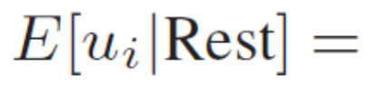
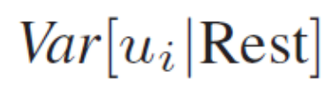
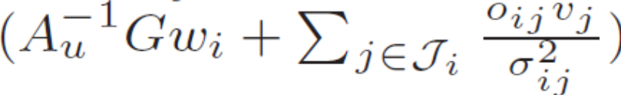
Monte Carlo E-step
Through a vanilla Gibbs sampler (conditionals closed form)
Other conditionals also Gaussian and closed form
Conditionals of users (movies) sampled simultaneously
Small number of samples in early iterations, large numbers in later iterations

Slide 35
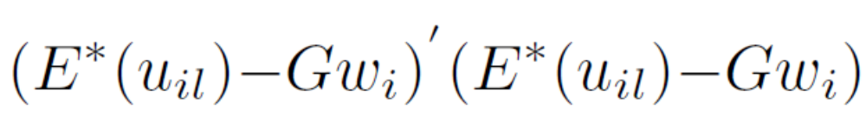
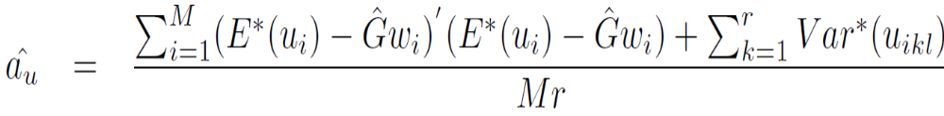
M-step (Why MCEM is better than ICM)
Update G, optimize
Update A_{u}=a_{u} I
Ignored by ICM, underestimates factor variability
Factors over-shrunk, posterior not explored well

Slide 36
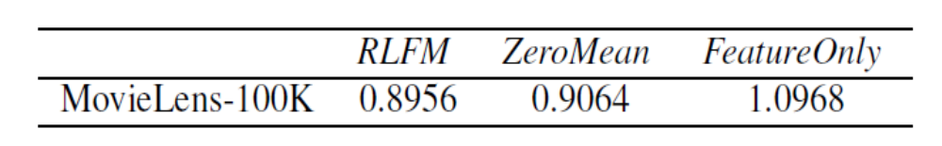
Experiment 1: Better regularization
MovieLens-100K, avg RMSE using pre-specified splits
ZeroMean, RLFM and FeatureOnly (no cold-start issues)
Covariates:
  Users : age, gender, zipcode (1st digit only)
  Movies: genres

Slide 37
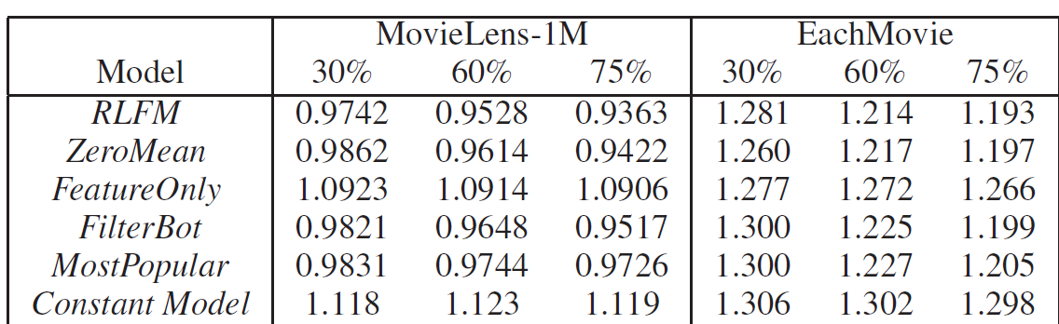
Experiment 2: Better handling of Cold-start
MovieLens-1M; EachMovie
Training-test split based on timestamp
Same covariates as in Experiment 1.

Slide 38
Experiment 4: Predicting click-rate on articles
Goal: Predict click-rate on articles for a user on F1 position
Article lifetimes short, dynamic updates important
User covariates:
  Age, Gender, Geo, Browse behavior
Article covariates
  Content Category, keywords
2M ratings, 30K users, 4.5 K articles

Slide 39
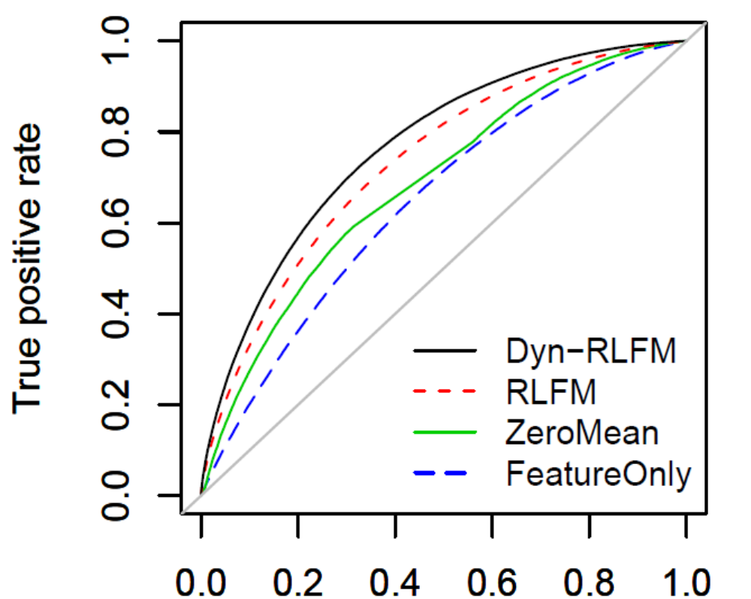
Results on Y! FP data

Slide 40
Some other related approaches
Stern, Herbrich and Graepel, WWW, 2009
  Similar to RLFM, different parametrization and expectation propagation used to fit the models
Porteus, Asuncion and Welling, AAAI, 2011
  Non-parametric approach using a Dirichlet process
Agarwal, Zhang and Mazumdar, Annals of Applied Statistics, 2011
  Regression + random effects per user regularized through a Graphical Lasso

Slide 41
Add Topic Discovery into
Matrix Factorization
fLDA: Matrix Factorization through Latent Dirichlet Allocation

Slide 42
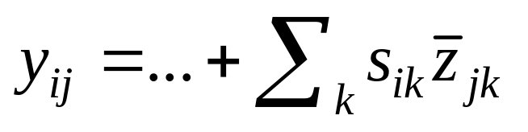
fLDA: Introduction
Model the rating y_{ij} that user i gives to item j as the user’s affinity to the topics that the item has
  Unlike regular unsupervised LDA topic modeling, here the LDA topics are learnt in a supervised manner based on past rating data
  fLDA can be thought of as a “multi-task learning” version of the supervised LDA model [Blei’07] for cold-start recommendation
User i ’s affinity to topic k
Pr(item j has topic k) estimated by averaging
the LDA topic of each word in item j
Old items: z_{jk}’s are Item latent factors learnt from data with the LDA prior
New items: z_{jk}’s are predicted based on the bag of words in the items

Slide 43
LDA Topic Modeling (1)
LDA is effective for unsupervised topic discovery [Blei’03]
  It models the generating process of a corpus of items (articles)
  For each topic k, draw a word distribution Φ_{k} = [Φ_{k1}, …, Φ_{kW}] ~ Dir(η)
  For each item j, draw a topic distribution θ_{j} = [θ_{j1}, …, θ_{jK}] ~ Dir(λ)
  For each word, say the nth word, in item j,
    Draw a topic z_{jn} for that word from θ_{j} = [θ_{j1}, …, θ_{jK}]
    Draw a word w_{jn} from Φ_{k} = [Φ_{k1}, …, Φ_{kW}] with topic k = z_{jn}
Item j
Topic distribution: [θ_{j1}, …, θ_{jK}]
Φ₁₁, …, Φ_{1W}
…
Φ_{k1}, …, Φ_{kW}
…
Φ_{K1}, …, Φ_{KW}
Topic 1
Assume z_{jn} = topic k
Topic k
Per-word topic: z_{j1}, …, z_{jn}, …
Topic K
Words: w_{j1}, …, w_{jn}, …
Observed

Slide 44
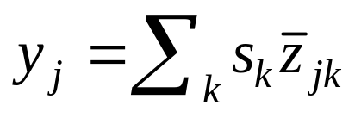
LDA Topic Modeling (2)
Model training:
  Estimate the prior parameters and the posterior topic×word distribution Φ based on a training corpus of items
  EM + Gibbs sampling is a popular method
Inference for new items
  Compute the item topic distribution based on the prior parameters and Φ estimated in the training phase
Supervised LDA [Blei’07]
  Predict a target value for each item based on supervised LDA topics
Regression weight for topic k
One regression per user
vs.
Same set of topics across different regressions
Target value of item j
Pr(item j has topic k) estimated by averaging
the topic of each word in item j

Slide 45
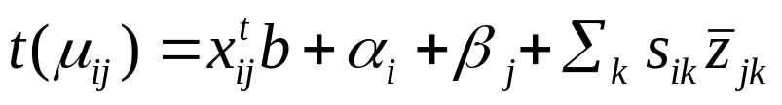
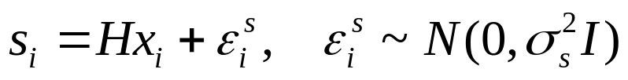
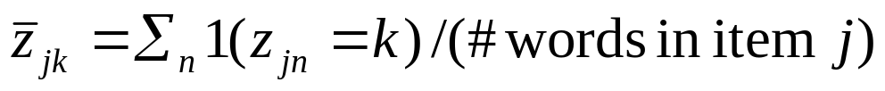
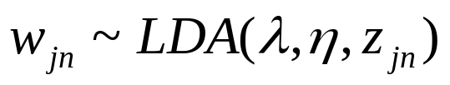
fLDA: Model
Rating:
Gaussian Model
user i
gives
item j
Logistic Model (for binary rating)
Poisson Model (for counts)
Bias of user i:
Popularity of item j:
Topic affinity of user i:
Pr(item j has topic k):
The LDA topic of the nth word in item j
Observed words:
The nth word in item j

Slide 46
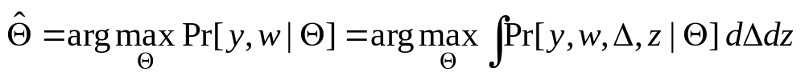
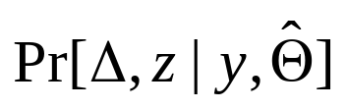
Model Fitting
Given:
  Features X = {x_{i}, x_{j}, x_{ij}}
  Observed ratings y = {y_{ij}} and words w = {w_{jn}}
Estimate:
  Parameters: Θ = [b, g₀, d₀, H, σ², a_{α}, a_{β}, A_{s}, λ, η]
    Regression weights and prior parameters
  Latent factors: Δ = {α_{i}, β_{j}, s_{i}} and z = {z_{jn}}
    User factors, item factors and per-word topic assignment
Empirical Bayes approach:
  Maximum likelihood estimate of the parameters:
  The posterior distribution of the factors:

Slide 47
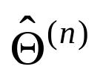
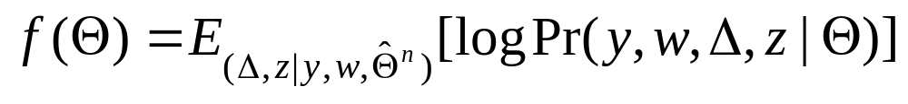

The EM Algorithm
Iterate through the E and M steps until convergence
  Let be the current estimate
  E-step: Compute
    The expectation is not in closed form
    We draw Gibbs samples and compute the Monte Carlo mean
  M-step: Find
    It consists of solving a number of regression and optimization problems

Slide 48

Supervised Topic Assignment
The topic of the nth word in item j
Probability of observing y_{ij}
given the model
Same as unsupervised LDA
Likelihood of observed ratings
by users who rated item j when
z_{jn} is set to topic k

Slide 49
fLDA: Experimental Results (Movie)
Task: Predict the rating that a user would give a movie
Training/test split:
  Sort observations by time
  First 75% → Training data
  Last 25% → Test data
Item warm-start scenario
  Only 2% new items in test data
Model | Test RMSE
RLFM | 0.9363
fLDA | 0.9381
Factor-Only | 0.9422
FilterBot | 0.9517
unsup-LDA | 0.9520
MostPopular | 0.9726
Feature-Only | 1.0906
Constant | 1.1190
fLDA is as strong as the best method
It does not reduce the performance in warm-start scenarios

Slide 50

fLDA: Experimental Results (Yahoo! Buzz)
Task: Predict whether a user would buzz-up an article
Severe item cold-start
  All items are new in test data
fLDA significantly outperforms other models
Data Statistics
1.2M observations
4K users
10K articles

Slide 51
Experimental Results: Buzzing Topics
3/4 topics are interpretable; 1/2 are similar to unsupervised topics
Top Terms (after stemming) | Topic
bush, tortur, interrog, terror, administr, CIA, offici, suspect, releas, investig, georg, memo, al | CIA interrogation
mexico, flu, pirat, swine, drug, ship, somali, border, mexican, hostag, offici, somalia, captain | Swine flu
NFL, player, team, suleman, game, nadya, star, high, octuplet, nadya_suleman, michael, week | NFL games
court, gai, marriag, suprem, right, judg, rule, sex, pope, supreme_court, appeal, ban, legal, allow | Gay marriage
palin, republican, parti, obama, limbaugh, sarah, rush, gop, presid, sarah_palin, sai, gov, alaska | Sarah Palin
idol, american, night, star, look, michel, win, dress, susan, danc, judg, boyl, michelle_obama | American idol
economi, recess, job, percent, econom, bank, expect, rate, jobless, year, unemploy, month | Recession
north, korea, china, north_korea, launch, nuclear, rocket, missil, south, said, russia | North Korea issues

Slide 52
fLDA Summary
fLDA is a useful model for cold-start item recommendation
It also provides interpretable recommendations for users
  User’s preference to interpretable LDA topics
Future directions:
  Investigate Gibbs sampling chains and the convergence properties of the EM algorithm
  Apply fLDA to other multi-task prediction problems
    fLDA can be used as a tool to generate supervised features (topics) from text data

Slide 53
Summary
Regularizing factors through covariates effective
Regression based factor model that regularizes better and deals with both cold-start and warm-start in a single framework in a seamless way looks attractive
Fitting method scalable; Gibbs sampling for users and movies can be done in parallel. Regressions in M-step can be done with any off-the-shelf scalable linear regression routine
Distributed computing on Hadoop: Multiple models and average across partitions

Slide 54

Hierarchical smoothing
Advertising application, Agarwal et al. KDD 10
Product of states for each node pair
Spike and Slab prior
  Known to encourage parsimonious solutions
    Several cell states have no corrections
  Not used before for multi-hierarchy models, only in regression
  We choose P = .5 (and choose “a” by cross-validation)
    a – psuedo number of successes
Advertiser
pubclass
Conv-id
Pub-id
campaign
z
Ad-id
(S_{z}, E_{z}, λ_{z})

